Slide 1
Pre -Final Term Defense on Face Recognition Using Discrete Cosine Transform And Convolution Neural Network
Prepared By:-
Bishal Thapa [BCT 110]
Mitra Prasad Poudel [BCT 120]
Ramesh Paswan [BCT 129]
Saugat Thapalia [BCT 138]

Slide 2
INTRODUCTION
Face recognition is a biometric method of identifying an individual with the captured image data with the stored record for that person.
Everyday actions are increasingly being handled electronically, instead of pencil and paper or face to face.
This growth in electronics transactions results in great demand for fast and accurate using identification and authentication.

Slide 3
WHY FACE RECOGNITION?

Slide 4
AIMS AND OBJECTIVES
AIMS
To develop a complete face recognition system.
OBJECTIVES
To develop a complete system to recognize the human faces.
To extract the unique characteristics features of face useful for face recognition

Slide 5
APPLICATIONS
Security
HCI-Human Computer Interaction
Law Enforcement
Voter verification
Banking using ATM

Slide 6
METHODOLOGY
General Face Recognition Diagram
Testing Image
Face CNN Model
Input Image
Classification
Image Pre-processing
Train CNN Network
Image Compression with DCT
Output
Face Dataset

Slide 7
IMAGE PRE-PROCESSING STEPS
Input Image
Gray scale Conversion
Image Geometrics Changing
Projected for Dimensional Reduction
Image Enhancement

Slide 8
Working of DCT
DCT (Discrete Cosine Transform)
Input Image
Divide into 8*8 Block
Face Feature Gallery
DC DCT Component Section

Slide 9
Working of Convolution Neural Network
Convolution Neural Network
Image Input from Dataset
Convolution
Max polling
Flattenning
Fully connected
Output

Slide 10
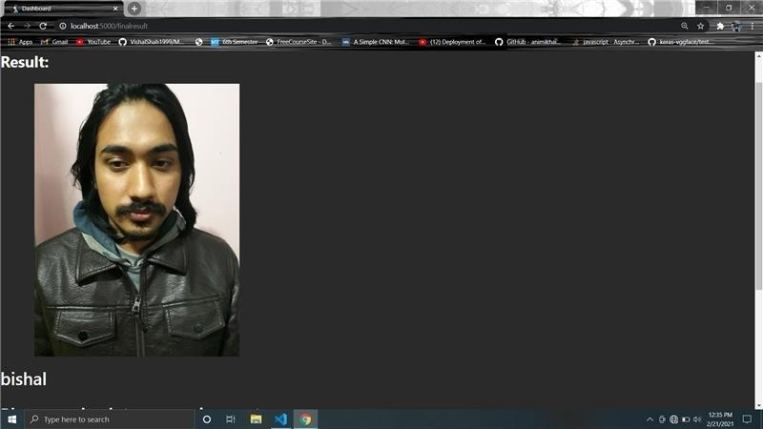
Obtained Output
10

Slide 11
Limitations
1. Face Detection
Difficult to detect face in complex backgrounds or in presence of multiple faces.
Low Detection rates.
Applicable only to frontal faces.
May not detect faces with beards.
2. Face Recognition
Small dataset leads to low recognition rate

Slide 12
Future Work
Modify any previous mentioned algorithm in order to enhance the recognition rate.
Expand the dataset to improve the performance of system.
Develop a web application to deploy this project.

Slide 13
Discussion

Slide 14
THANK YOU !!

